Slide 1

Automation Testing
By- Manas

Slide 2
DATA FROM NOTEPAD/TEXT FILE
We are using this option to read data from notepad to test script. For working with notepad, we need to import FileReader and BufferedReader classes by creating objects.

Slide 3
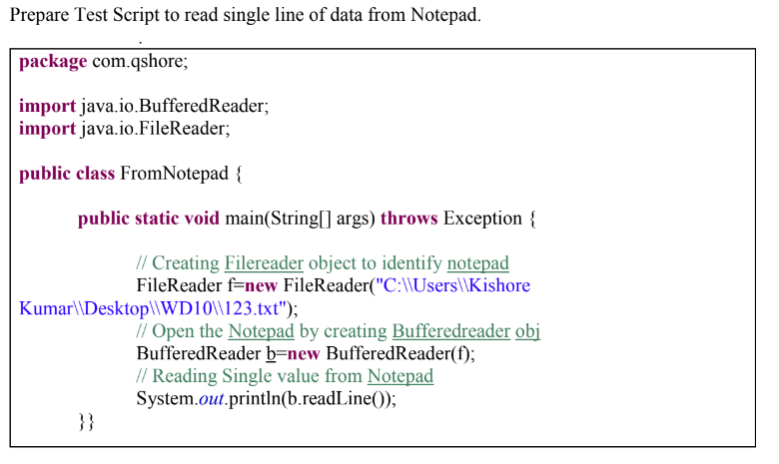

Slide 4
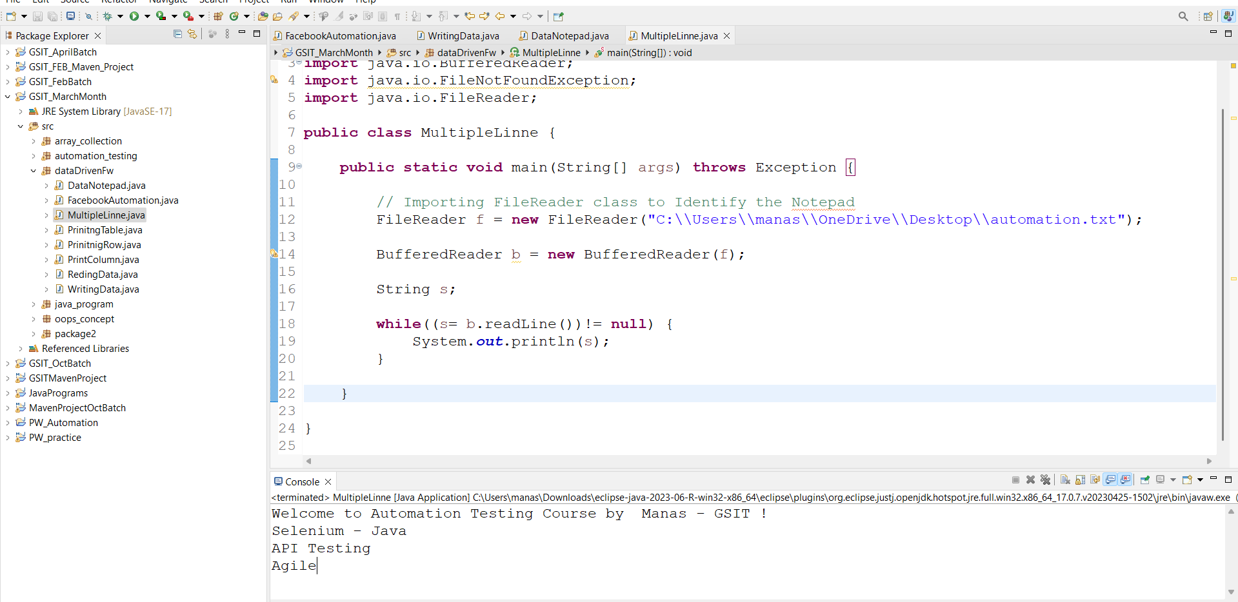

Slide 5
Writing Data into Notepad
We are using this option to write output into notepad through test script. For writing data into notepad, we need to import “FileWriter” and “BufferedWriter” classes by creating objects.

Slide 6
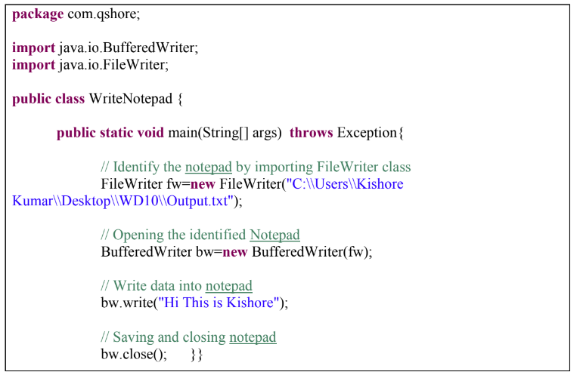
Prepare Test Script to write data into notepad.

Slide 7
